Slide 1
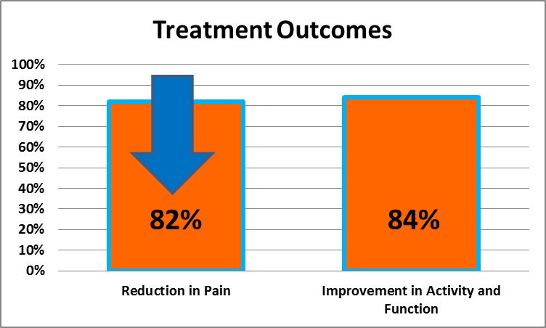
AmnioFix® Regenerative Injection in Achilles Tendinopathy
Alberto Abrebaya DPM, DABPS, FAPWCA West Palm Beach VA
Background and Purpose
Results
For varying anatomical reasons, the Achilles tendon is subject to tendinosis, insertional enthesitis and intrasubstance tears with tendinopathy.
Injectable, micronized dehydrated human amnion/chorion membrane (AmnioFix®, MiMedx, Marietta, GA) delivers essential growth factors and extracellular matrix proteins, collagen, and reduces Inflammation.
A previous study in patients with plantar fasciitis has shown that treatment with AmnioFix® improves functional rates and subjective pain scales from enhanced soft tissue healing.¹
Our purpose is to discern the effectiveness of AmnioFix® for treatment of Tendoachilles enthesopathy and tendinopathy.
Client | Age Laterality | Diagnosis | Pain Rating Start—Finish | Activity rating Start—Finish | Function rating Start—Finish | Total dose
1 | 67 left | TENDINOSIS ENTHESOPATHY | 8 2 | 1 5 | 1 5 | 1.25 G
2 | 59 right | TENDINOPATHY SUBSTANCE TEAR | 8 1 | 2 5 | 2 5 | 1.25 G
3 | 52 right/left | TENDINOSIS ENTHESOPATHY | 7 0 | 2 5 | 2 5 | 1.25 G
4 | 41 right/left | TENDINOSIS ENTHESOPATHY | 10 2 | 1 5 | 1 5 | 1.25 G
5 | 58 right/left | TENDINOSIS ENTHESOPATHY | 9 1 | 0 4 | 0 4 | 1.25 G
6 | 48 right/left | TENDINOPATHY SUBSTANCE TEAR | 7 1 | 1 5 | 1 5 | 1.25 G
7 | 43 right | TENDINOPATHY SUBSTANCE TEAR | 9 2 | 0 4 | 0 4 | 1.25 G
8 | 41 right/left | TENDINOSIS ENTHESOPATHY | 7 0 | 1 4 | 1 4 | 1.25 G
9 | 59 left | TENDINOSIS ENTHESOPATHY | 8 1 | 0 4 | 0 4 | 1.25 G
10 | 55 right/left | TENDINOPATHY SUBSTANCE TEAR | 8 2 | 1 5 | 1 5 | 1.25 G
11 | 59 right/left | TENDINOSIS ENTHESOPATHY | 9 3 | 0 4 | 0 4 | 1.25 G
12 | 66 right | TENDINOPATHY SUBSTANCE TEAR | 8 2 | 0 5 | 0 5 | 1.25 G
13 | 53 right | TENDINOSIS ENTHESOPATHY | 10 1 | 1 5 | 1 5 | 1.25 G
14 | 45 right/left | TENDINOSIS ENTHESOPATHY | 9 3 | 1 4 | 1 4 | 1.25 G
15 | 64 right/left | TENDINOPATHY SUBSTANCE TEAR | 8 1 | 0 4 | 0 4 | 1.25 G
16 | 72 right/left | TENDINOSIS ENTHESOPATHY | 10 2 | 1 5 | 1 5 | 2.0 G
Mean |  |  | 8.4 1.5 | 0.75 4.6 | 0.75 4.6
Methods
Twenty-six feet of 22 consecutive patients with MRI-evidenced Achilles tendinosis and tendinopathy of moderate to high degree were treated with AmnioFix®.
Treatment with AmnioFix® was initiated in the second or third subsequent visits approximately 30 to 45 days post initial diagnosis.
The technique for injection was preceded by antisepsis of the injection site involved and placement of sterile field.
The injection consisted of 100 mg of AmnioFix® reconstituted in 2mL of 1% Lidocaine plain.
A hypodermic injection using a sterile 25 or 27 gauge needle through the substance of the Tendoachilles into the previously identified pathologic region of hypertrophic tendinopathy at the critical zone and/or the insertional enthesopathic region.
72.7% of patients (16/22) with Achilles tendinopathy treated with AmnioFix® experienced decreased pain with corresponding increases in activity and function.
One patient received a second injection during the care regimen for persistent disabling calcific insertional enthesopathy and tendinopathy though symptoms mitigated at the 6th week interval.
Initial reaction to amniotic allograft injection produced an occasional reaction in the initial 24 hour period whereby an inflammatory infiltrate produced pain, hyperemia, and swelling of the injected areas. (On one rare occasion, a localized atopic urticaria was documented, but was likely related to hypersensitivity to Coban compressive dressing rather than the amniotic allograft).
This phase lasted approximately 48 to 72 hours without clinical evidence of graft-host rejection.
Patients were placed on rigid ankle walking braces for protected weighted ambulation, and prescription of enteral narcotic analgesics if necessary. NSAIDs were withheld during treatment.
Conclusion
Injection of micronized amnion/chorion membrane (AmnioFix®) appears effective for the treatment of Tendoachilles musculoskeletal anomalies including insertional enthesopathy, tendinosis with tendinopathy of the critical zone.
Reference
Zelen CM, Poka A, Andrews J. Prospective, randomized, blinded, comparative study of injectable micronized dehydrated amniotic/chorionic membrane allograft for plantar fasciitis--a feasibility study. Foot Ankle Int. Oct;34(10):1332-9.
AmnioFix® is a registered trademark of MiMedx Group, Inc.

